Slide 1
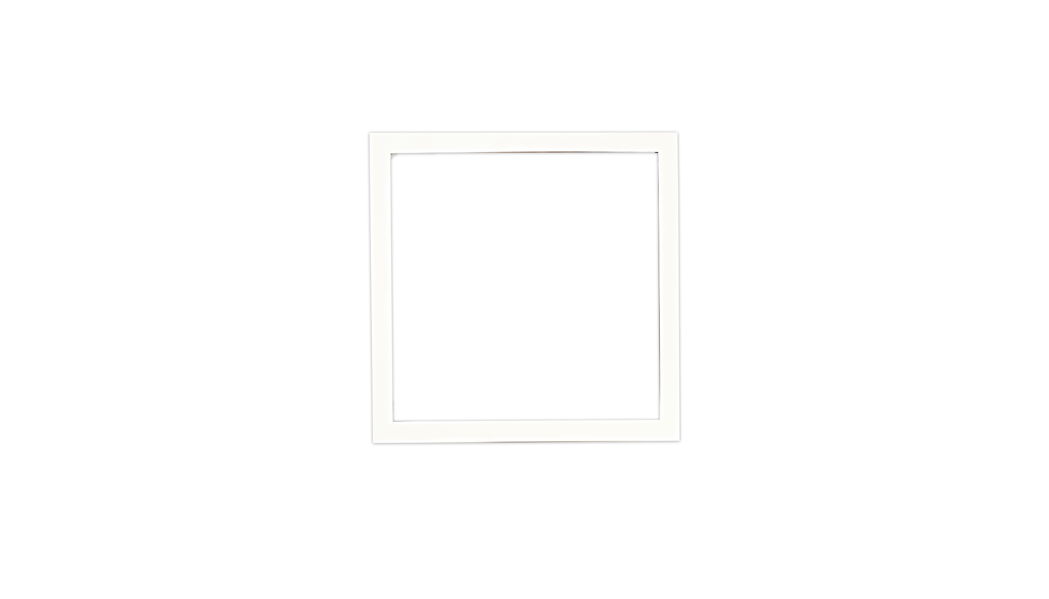
High School Life in Japan

Slide 2

Contents of this template
Fonts
Colors
Thanks slide
Icons and infographics
To view this template correctly in PowerPoint, download and install the fonts we used
You can see on the link all the colors used i this presentation
You must keep it so that proper credits for our design are given
These can be used in the template, and their size and color can be edited
For more info: SLIDESGO | SLIDESGO AI TOOLS | BLOG | FAQs
You can edit the master slides easily. For more info, click here
You can visit our sister projects: FREEPIK AI TOOLS | FREEPIK LIBRARY RESOURCES
You can delete this slide when you’re done editing the presentation

Slide 3
Table of contents
01
05
02
06
03
07
04
08
Name of the section
Name of the section
Name of the section
Name of the section
Name of the section
Name of the section
Name of the section
Name of the section

Slide 4
Name of
the section
01

Slide 5
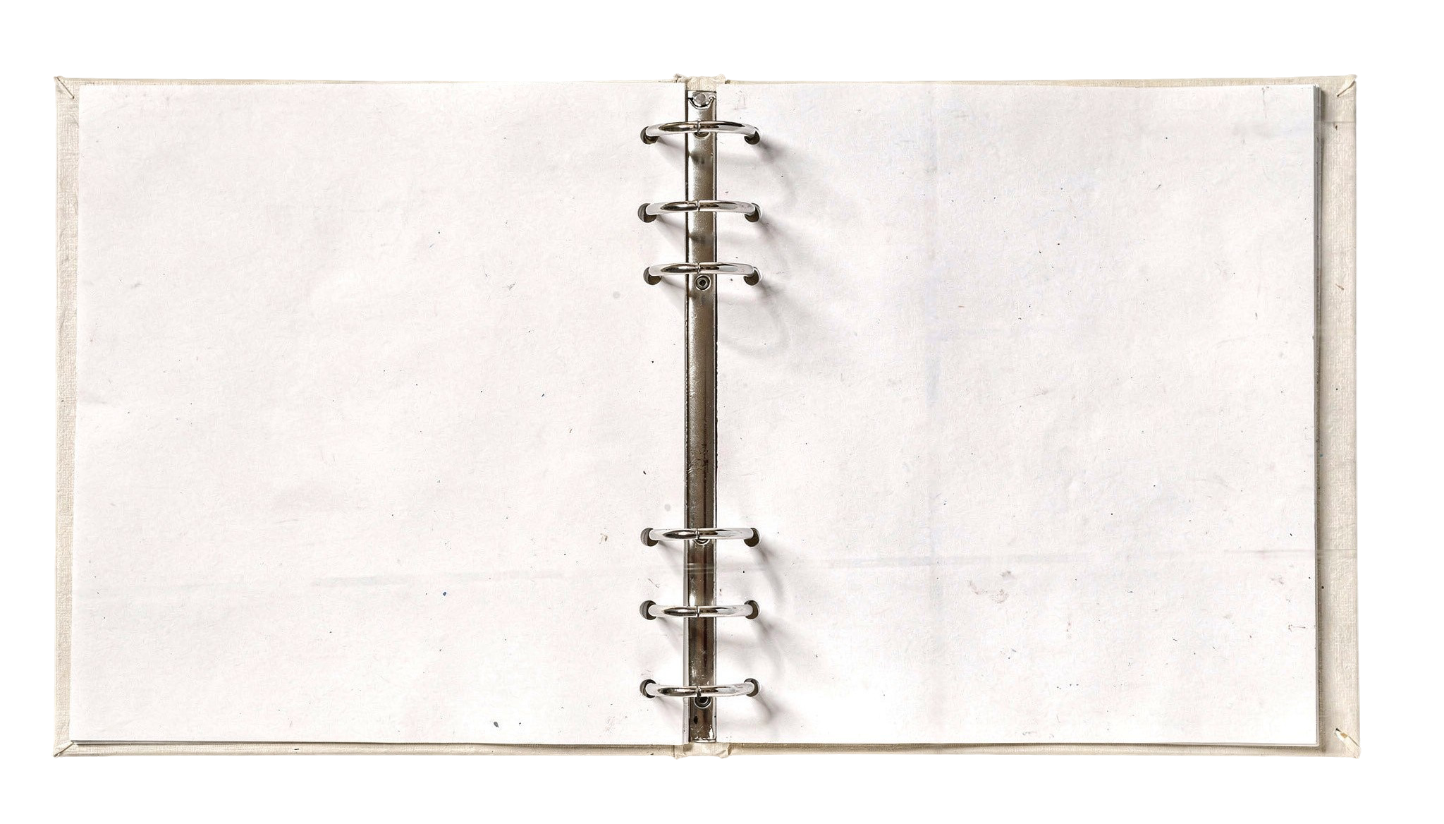
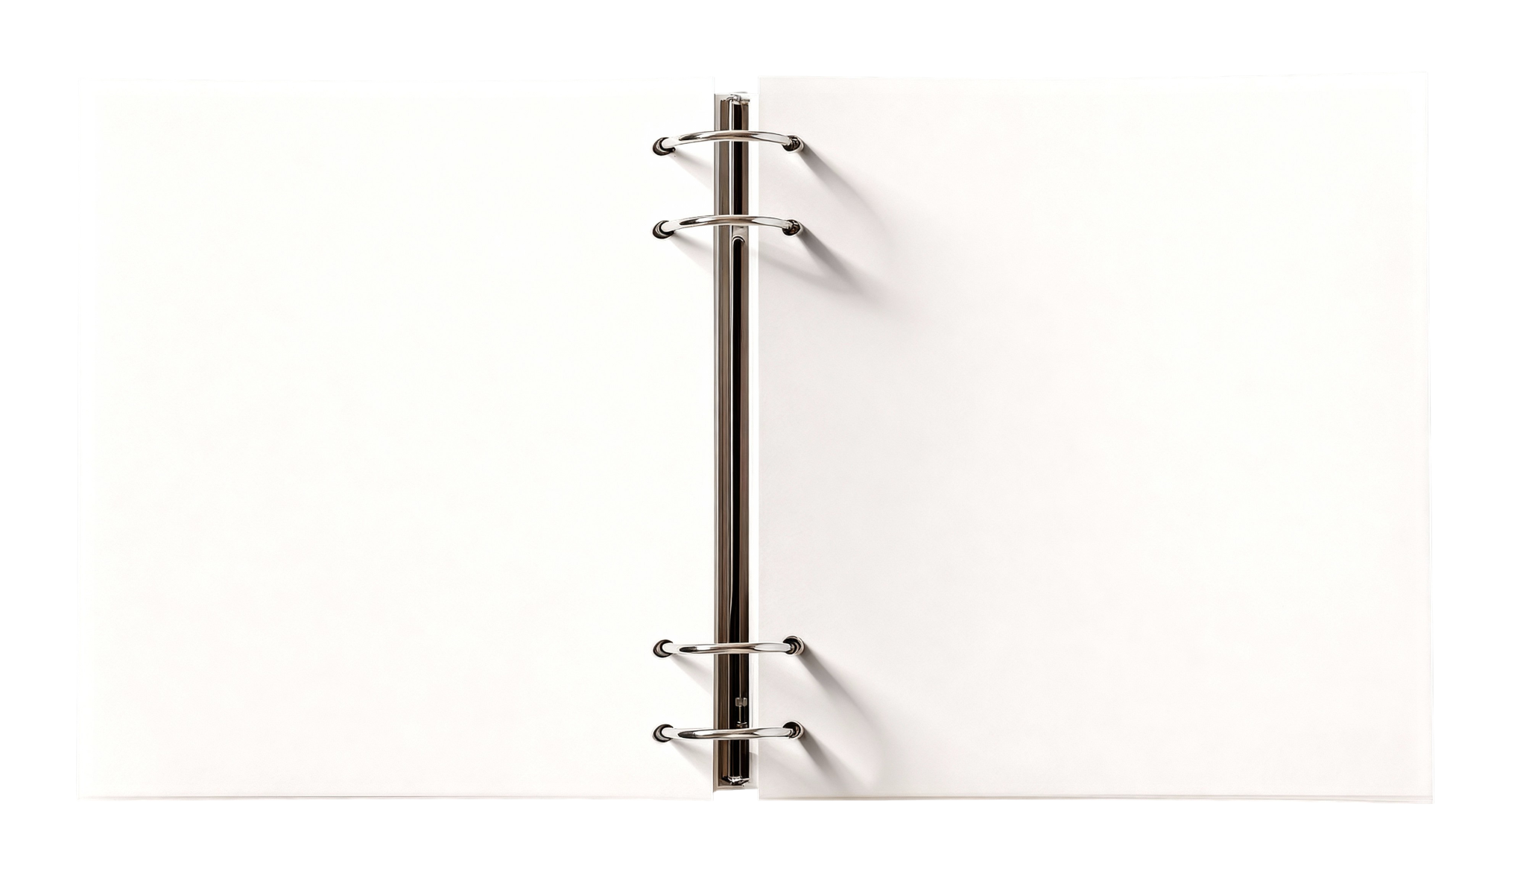
You can write here a long title to captivate the audience attention
Do you know what helps you make your
point clear? Lists like this one:
They’re simple
You can organize your ideas clearly
You’ll never forget to buy milk!
You can replace the image. Just
right-click on it and select
“Replace image”

Slide 6
Let’s have a look
Mercury is the closest planet to the Sun and the smallest one in the entire Solar System. This planet’s name has nothing to do with the liquid metal, since Mercury was named after the Roman messenger god. Despite being closer to the Sun than Venus, its temperatures aren't as terribly hot as that planet’s. Its surface is quite similar to that of Earth’s Moon,
which means there are a lot of craters and plains.
Speaking of craters, many of them were named after artists or authors who made significant contributions to their respective fields. Mercury takes a little more than 58 days to complete its rotation, so try to imagine how long days must be there!

Slide 7
Two ideas
Let’s learn about Mercury
Let’s take a look at Venus
Mercury is the closest planet to the Sun and the smallest one in the Solar System. This planet’s name has nothing to do with the liquid metal
Venus has a beautiful name and is the second planet from the Sun. It’s hot and is the second-brightest natural object in the night sky

Slide 8
Six different ideas
01
04
02
05
03
06
Mercury is the smallest planet in the Solar System
Jupiter is the biggest planet in the Solar System
Venus is the second planet from the Sun
Saturn is composed of hydrogen and helium
Despite being red, Mars is actually a cold place
Neptune is the farthest planet from the Sun

Slide 9
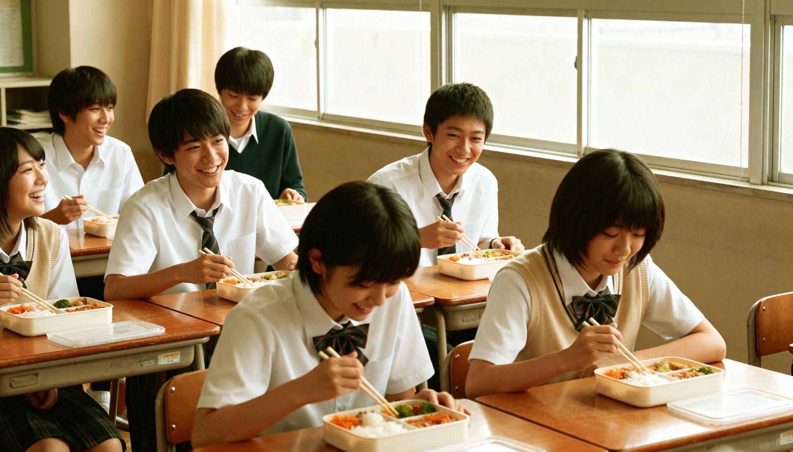
A picture is worth a thousand words

Slide 10
This is a timeline
01
02
03
04
This is Venus
This is Saturn
This is Mars
This is Neptune
Venus is the second planet from the Sun
Saturn is composed
of hydrogen and helium
Despite being red, Mars is actually a cold place
Neptune is the farthest planet from the Sun

Slide 11
Thank you
Do you have any questions?
youremail@freepik.com
+00 000 000 000
yourwebsite.com
Please keep this slide for attribution

